Slide 1
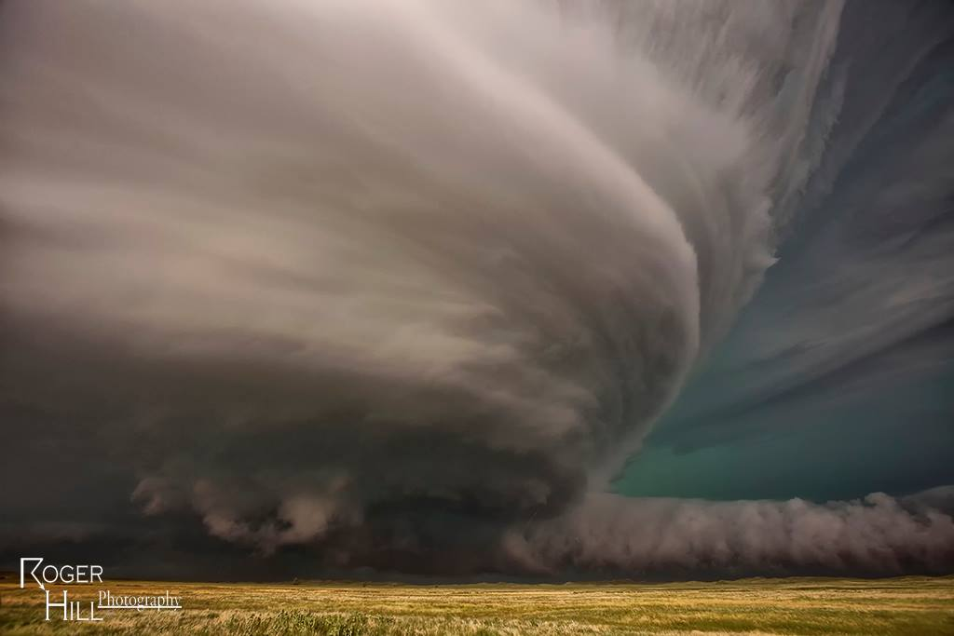
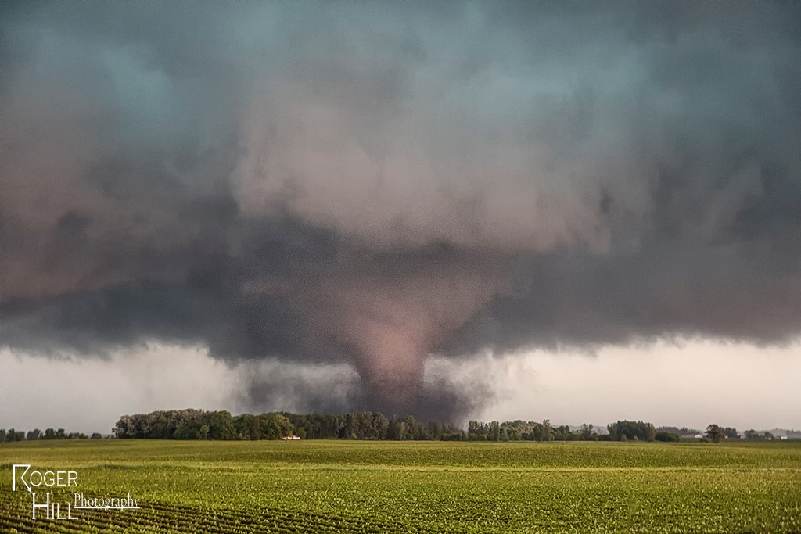
SCP & STP
The Parameters of all Parameters!*
*If used correctly under the conditions outlined herein. Users assume full responsibility when utilizing these (and all) convective parameters.
Material created by Rich Thompson
Arranged by Andrew Moore/Lyons

Slide 2
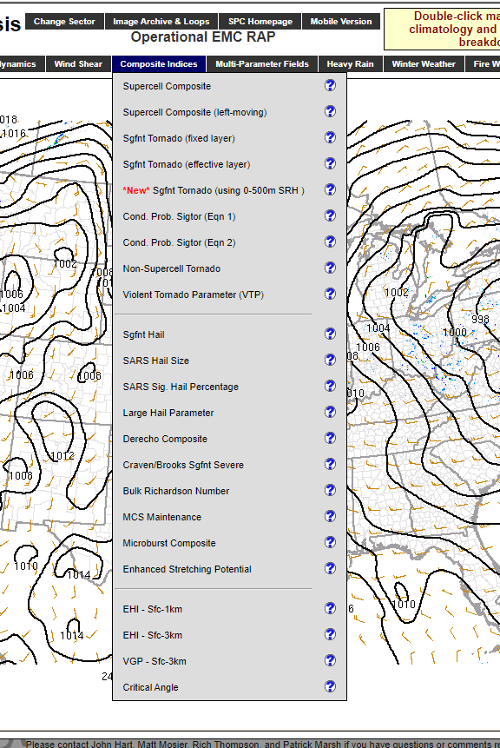
What is a composite parameter?
What is a parameter?
A numerical or other measurable factor forming one of a set that defines a system or sets the conditions of its operation. In meteorology:
An equation or multiple sets of equations that produce a scaled numerical output based on one or more numerical inputs. Usually produced by mixing forecast inputs to get a useful output. Examples:
Significant Hail parameter
Derecho Composite
Non-Supercell Tornado
SHERBE
EHI (Energy Helicity Index)
Numerous other forecast examples.

Slide 3
SCP & STP
What are they?
Supercell Composite Parameter
Significant Tornado Parameter
Thompson et al. 2004
Thompson et al. 2012
Notes:
Based on parameter space alone, the 2% tornado threat appears appropriate.

Slide 4
SCP & STP
What are they?
Convective parameters that try to discriminate between environments that can support right-moving supercells (SCP) and the associated threat for significant (EF-2+) tornadoes (STP).
(i.e. the most impactful convection!)

Slide 5
SCP & STP
In general, these parameters work well when used appropriately, but let’s take a closer look at:
How they’re derived
When to use them
Nuances

Slide 6
SCP
Recall what is needed for a supercell:
An initial updraft (buoyancy)
Vertical wind shear
The updraft tilts and stretches ambient environmental horizontal vorticity
Leads to mesocyclone development and supports a stronger, longer-lived storm.

Slide 7
SCP
Let’s consider each:
Buoyancy - Easy! We already know how to calculate that!
SBCAPE MLCAPE MUCAPE
But which one to use?

Slide 8
Elevated vs. high based
Elevated != High based
High-based convection is often still surface based.
Effective inflow layer shows this discrimination
Cold stable layer
Elevated Convection
Surface High-based mixed PBL High LCL
Surface based mixed PBL Low LCL

Slide 9
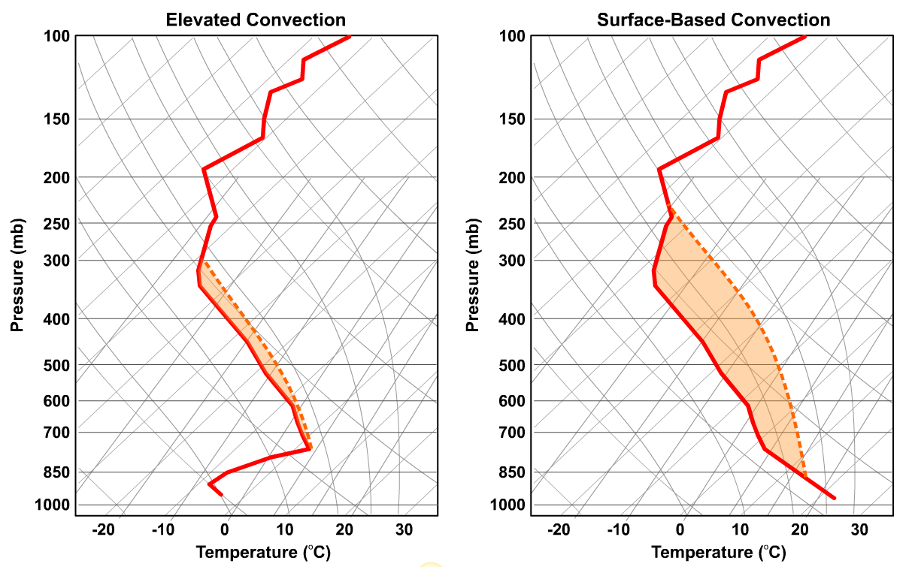

Slide 10
SCP
Let’s consider each:
Buoyancy - Easy! We already know how to calculate that!
SBCAPE MLCAPE MUCAPE
We’ll use MUCAPE to capture all thunderstorm environments

Slide 11
SCP
Let’s consider each:
Vertical wind shear - Also easy!
We’ll use Effective BWD and Effective SRH since they capture shallow and deep buoyancy environments as well as elevated thunderstorm environments.
0-6 km BWD
Effective BWD
0-1 km SRH
0-3 km SRH
Effective SRH
Favorable for organized convection
Favorable for supercells (target phenomenon)

Slide 12
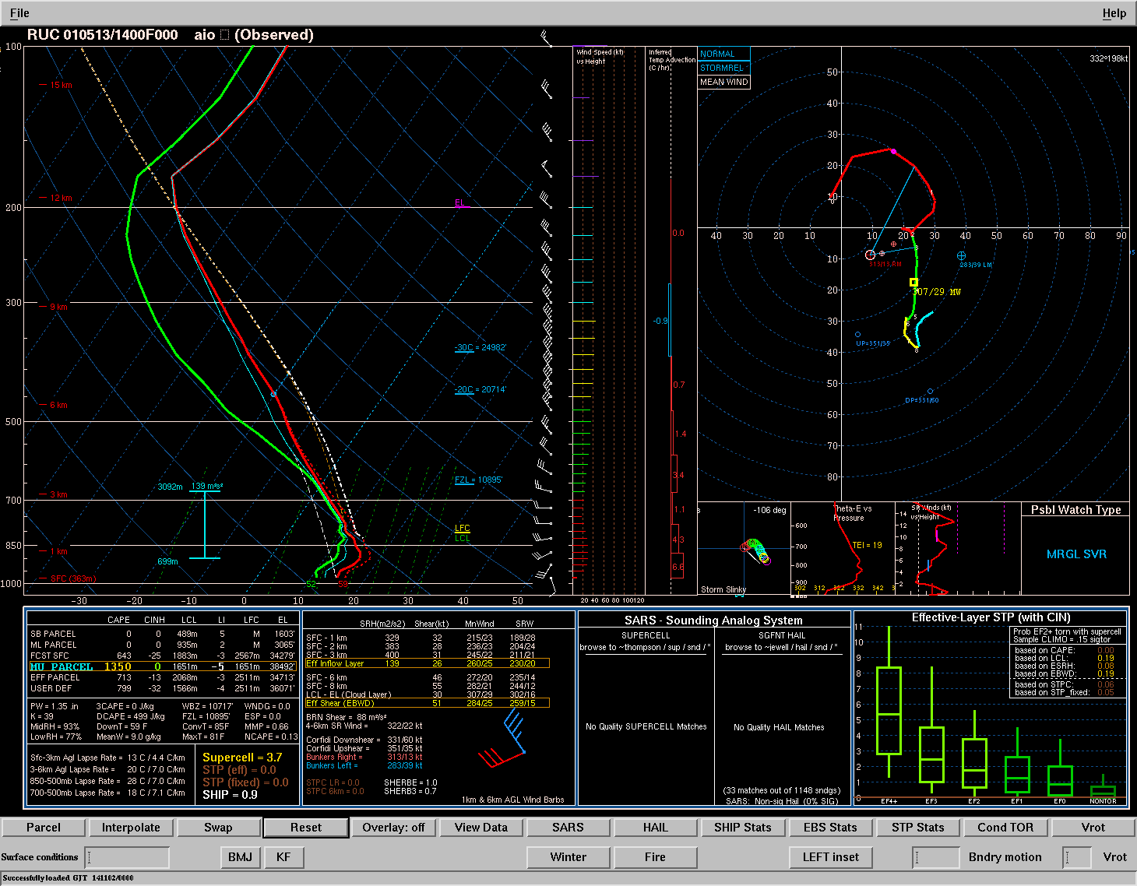
Low-level shear
0-1 km SRH
Effective Layer SRH
Which is going to matter more to an updraft?

Slide 13
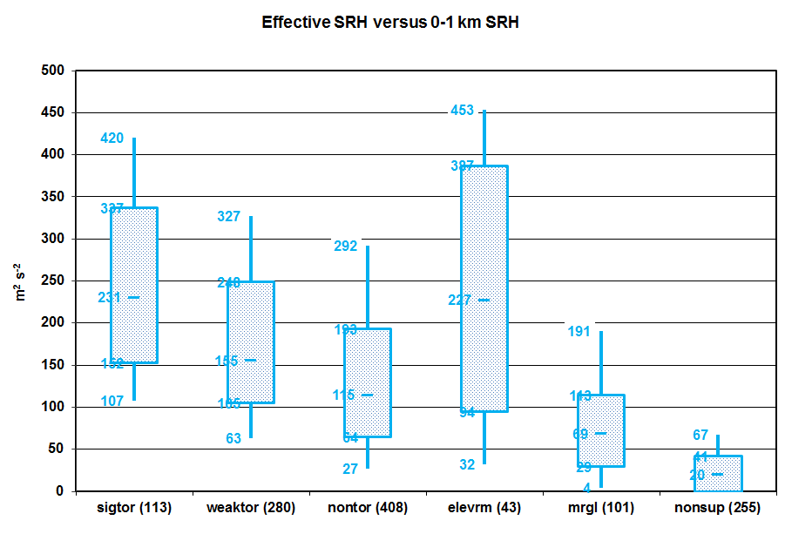
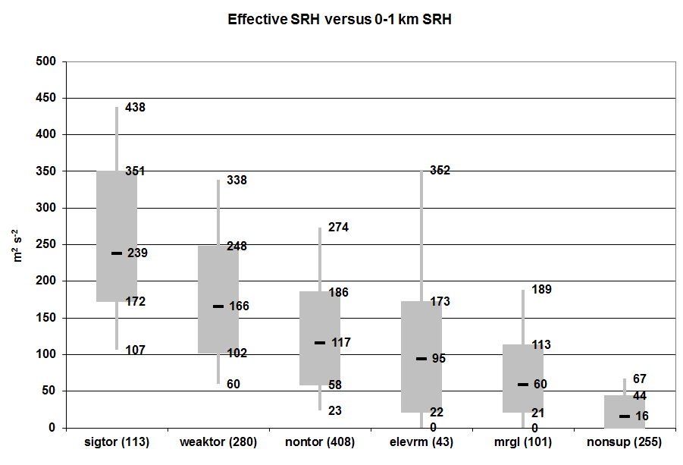
Low-level shear
0-1 km SRH
Effective Layer SRH

Slide 14
SCP
Three steps involved:
Combine terms of buoyancy and shear that are
relevant to supercell formation.
Normalize these terms to climatological distributions
Combine the terms for a final product

Slide 15
SCP
Three steps involved:
Combine terms of buoyancy and shear that are
relevant to supercell formation.
Normalize these terms to climatological distributions
Combine the terms for a final product

Slide 16
SCP
SCP = f(MUCAPE, MUCIN, EBWD, ESRH)
Measure of instability
Measure of inhibition
Deep-layer
shear
Low-level
shear

Slide 17
SCP
Three steps involved:
Combine terms of buoyancy and shear that are
relevant to supercell formation.
Normalize these terms to climatological distributions
Combine the terms for a final product

Slide 18
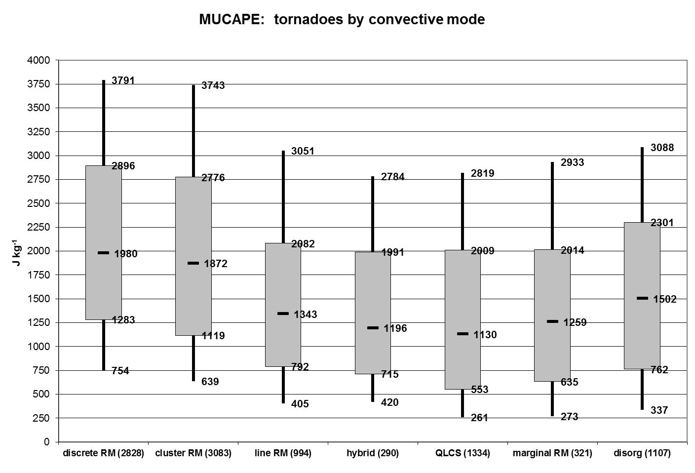
Want to isolate these!

Slide 19
SCP
SCP = f(MUCAPE, MUCIN, EBWD, ESRH)
1000
MUCAPE <= 1000: term = 0 to 1.0
MCAPE > 1000: term = 1.0+

Slide 20
SCP
SCP = f(MUCAPE, -40 , EBWD, ESRH)
1000
MUCIN
MUCIN > -40: term = 1.0
MUCIN <= -40: term 0.0 to 1.0
(term decreases with increasing MUCIN)

Slide 21
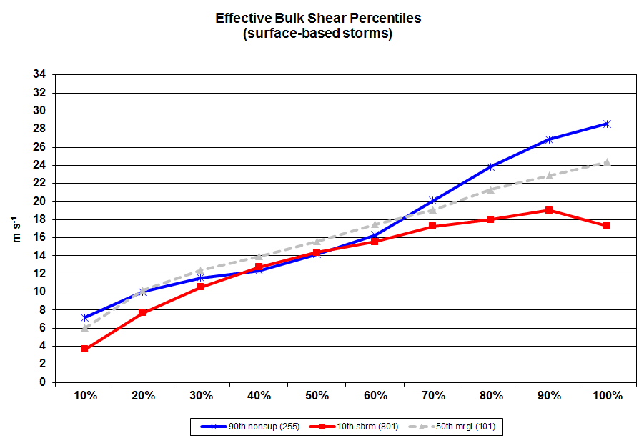
Strongest BWD with non-supercell storms
(top “whisker”)
Weakest BWD with supercell storms
(bottom “whisker”)

Slide 22
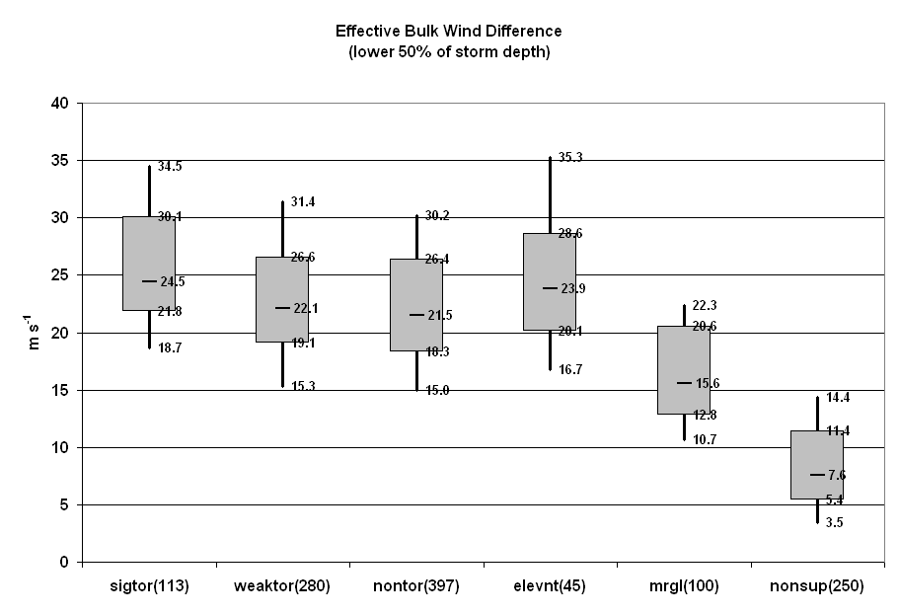
Want to isolate these!

Slide 23
SCP
SCP = f(MUCAPE, -40 , EBWD , ESRH)
1000
MUCIN
20
Note:
This is done so that environments with very high shear/very low CAPE don’t give false alarms
(think bulk Richardson #).
EBWD >= 20: term = 1.0
10 < EBWD < 20: term 0.0 to 1.0
EBWD < 10: term = 0.0

Slide 24
Want to isolate these!

Slide 25
SCP
SCP = f(MUCAPE, -40 , EBWD , ESRH)
1000
MUCIN
20
50
ESRH <= 50: term = 0.0 to 1.0
ESRH > 50: term = 1.0+

Slide 26
SCP
Three steps involved:
Combine terms of buoyancy and shear that are
relevant to supercell formation.
Normalize these terms to climatological distributions
Combine the terms for a final product

Slide 27
SCP
SCP = MUCAPE * -40 * EBWD * ESRH
1000
MUCIN
20
50
Multiplying the terms allows for:
One (or more) terms to compensate for a weakness
The parameter to go to zero if one term is not in place
(ex: no CAPE)

Slide 28
SCP
SCP = MUCAPE * -40 * EBWD * ESRH
1000
MUCIN
20
50
Also note:
MUCAPE and ESRH are the two main drivers of high SCP values!

Slide 29
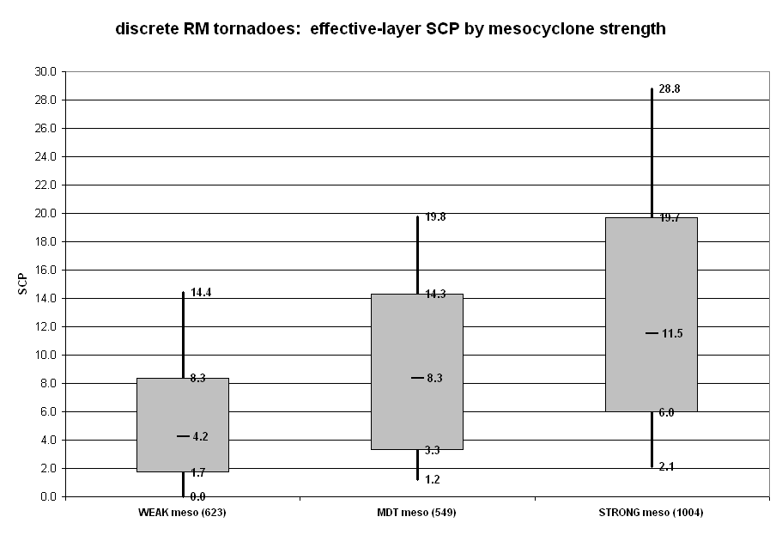
Weaker rotation – smaller SCP
Stronger rotation – larger SCP

Slide 30
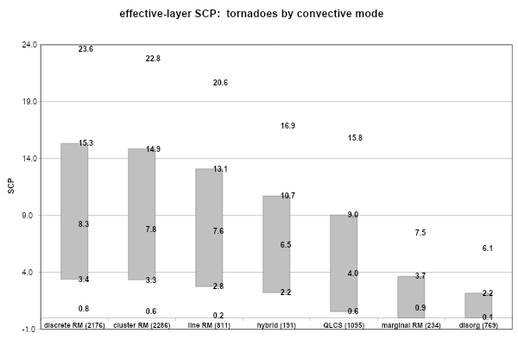

Slide 31
SCP Strengths
Simple estimate of conditional supercell potential
Covers a wide range of environments
(surface-based and elevated)
Has a physical basis in relevant processes for supercells

Slide 32
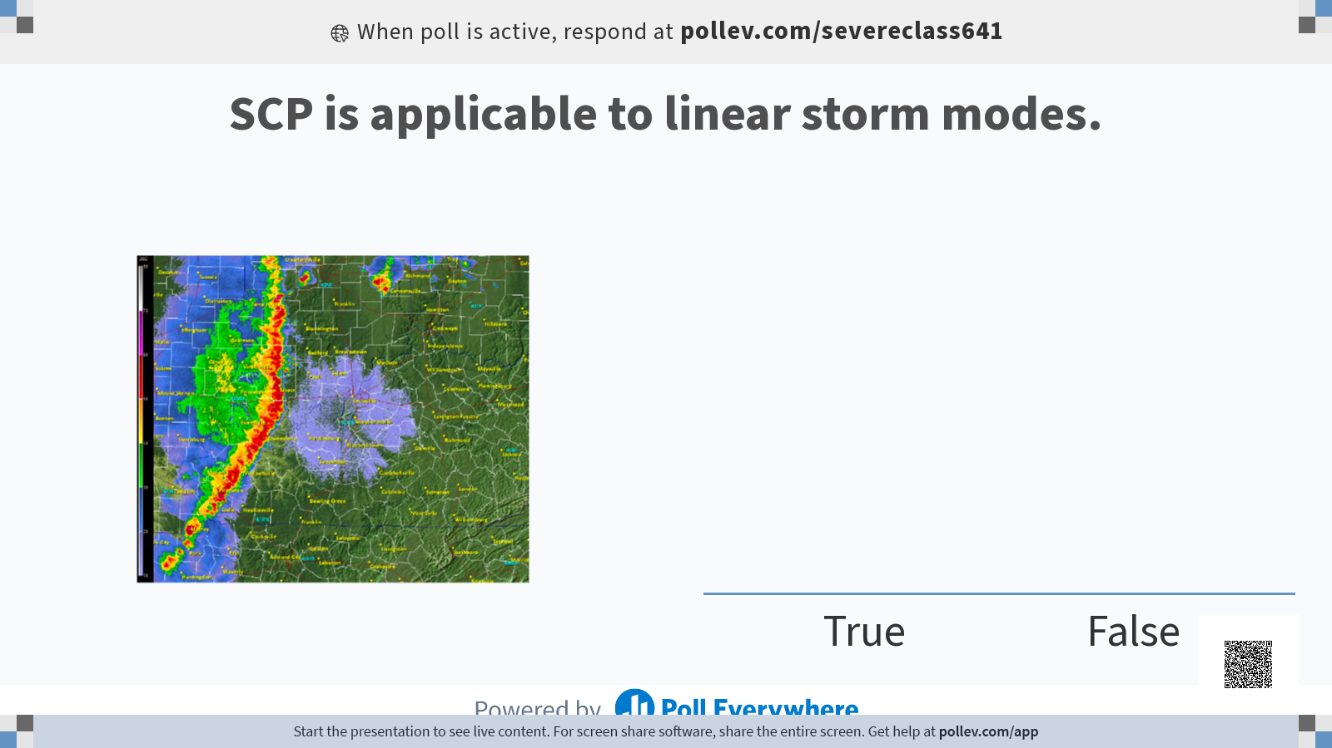

Slide 33
SCP Weaknesses
Conditional on having a right-moving supercell!
Does not consider:
Convective initiation
Storm mode
Sensitive to storm-motion estimate
Uses Bunker’s right-moving storm motion estimate.
Storm motion will influence ESRH, which will influence SCP.
Assumes you have a right-moving supercell, so may not be relevant for the early stages of storm development.

Slide 34
STP
Utilizes the same “philosophy” as SCP
Goal is to discriminate between environments that can/can’t support significant tornadoes

Slide 35
Near-surface Rotation
Does NOT come from environmental horizontal vorticity (SRH)
Environmental vorticity helps develop and strengthen the parent mesocyclone.
Observational & numerical simulation studies suggest the source for surface rotation:
Is baroclinically generated
Either along the FFCB or RFD
Still under study - stay tuned!

Slide 36
STP Considerations Pt. 1
Want to prioritize mesocyclonic tornado production
Utilize some concepts from SCP
Looking for right-moving, long-lived supercell
The need for buoyancy & deep-layer shear are still relevant
But need to adjust our focus to buoyancy, inhibition, and vertical shear near the ground
Need to estimate the potential for strong mesocyclone and low-level stretching
Need to estimate the potential for evaporative cooling in the RFD
recall low-level horizontal vorticity production from tornado lecture
This gives us an idea of the low-level resistance to stretching

Slide 37
STP Considerations Pt. 2
Need sustained, (near) surface-based supercell environments
Requires buoyancy/shear (MLCAPE, MLCIN, EBWD)
Need strong, low-level source of stretching
Generally comes in the form of a strong negative pressure perturbation associated with the mesocyclone (ESRH)
Need to estimate the resistance to stretching
MLCAPE, MLCIN, MLLCL

Slide 38
STP
STP = f(MLCAPE, MLCIN, EBWD, ESRH, MLLCL)
Deep-layer
Shear
Necessary
Factor
Low-level
Shear
Driving factor
Measure of surface
(or near-surface)
based instability
Driving factor
Measure of surface
(or near-surface)
based inhibition
Limiting factor
Measure of near-surface downdraft air buoyancy/stretching potential
Limiting factor

Slide 39
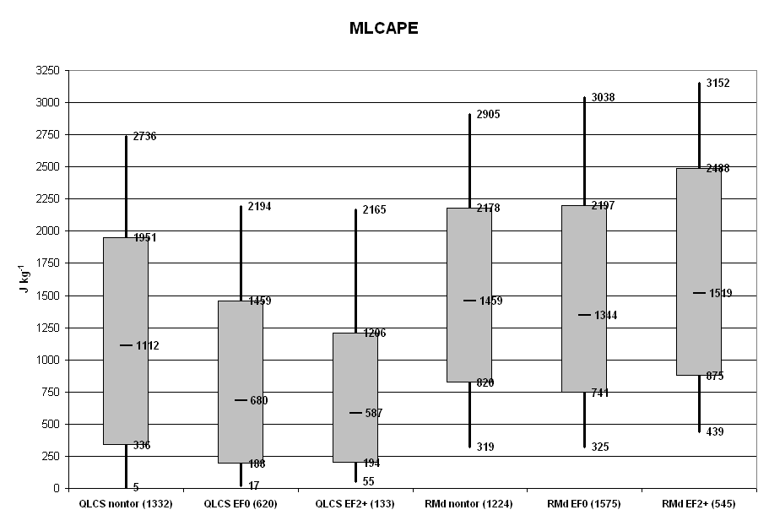
Want to isolate these!
Threshold set to 1500 J/kg in order to better
match the contribution of ESRH
(See Thompson et al. 2004 for details)
Notes:
Notice this excludes most QLCS-based tornadoes...

Slide 40
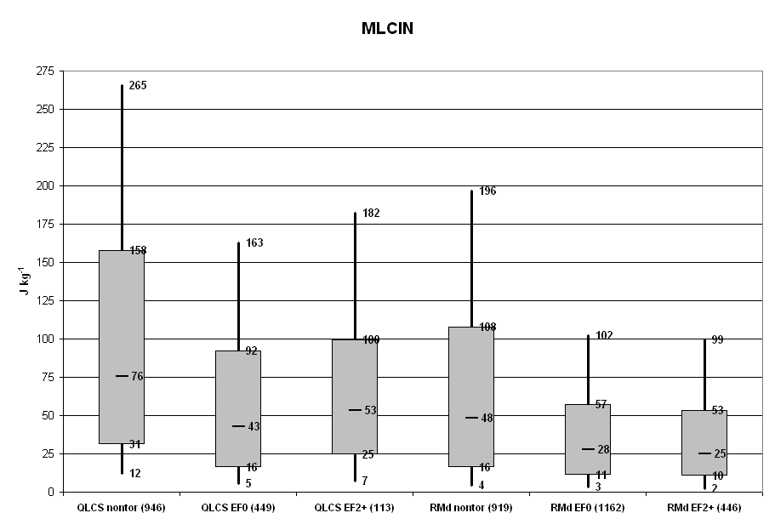
Want to isolate these!

Slide 41
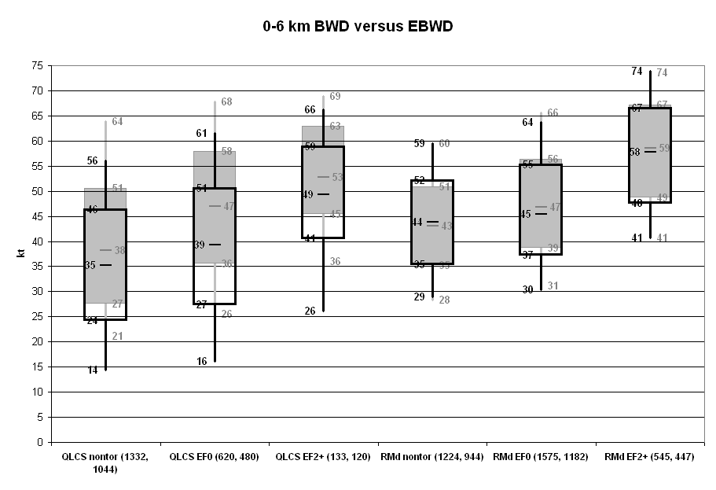
Want to isolate these!

Slide 42
Want to isolate these!

Slide 43
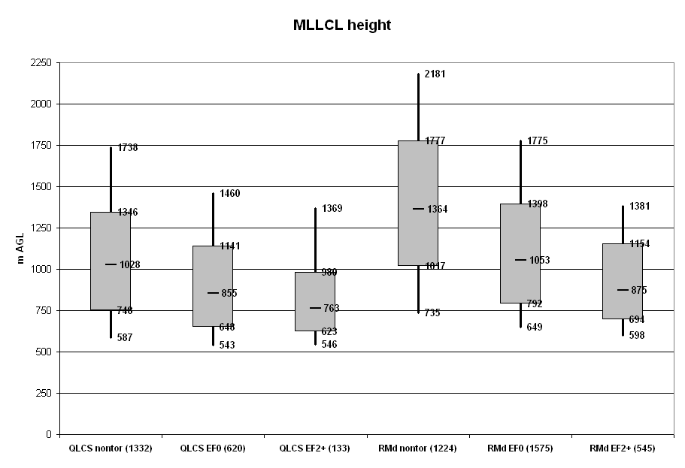
Want to isolate these!

Slide 44
STP =
MLCAPE
1500
(200+MLCIN)
150
EBWD
20
ESRH
150
(2000 - MLLCL)
1000
*
*
*
*

Slide 45
Goes to 0 as MLCIN decreases
(magnitude increases)
Set to 1 if MLCIN > -50
Goes to 0 as ESRH decreases
Set to zero if the bottom of the Eff. Inflow Layer is above the surface
MLCAPE
1500
(200+MLCIN)
150
EBWD
20
ESRH
150
(2000 - MLLCL)
1000
*
*
*
*
Goes to 0 as MLCAPE decreases.
Set to 0 if EBWD < 12.5 m/s
Set to 1.5 if EBWD > 30 m/s
Set to 0 if MLLCL > 2000 m
Set to 1.0 if MLLCL < 1000 m

Slide 46
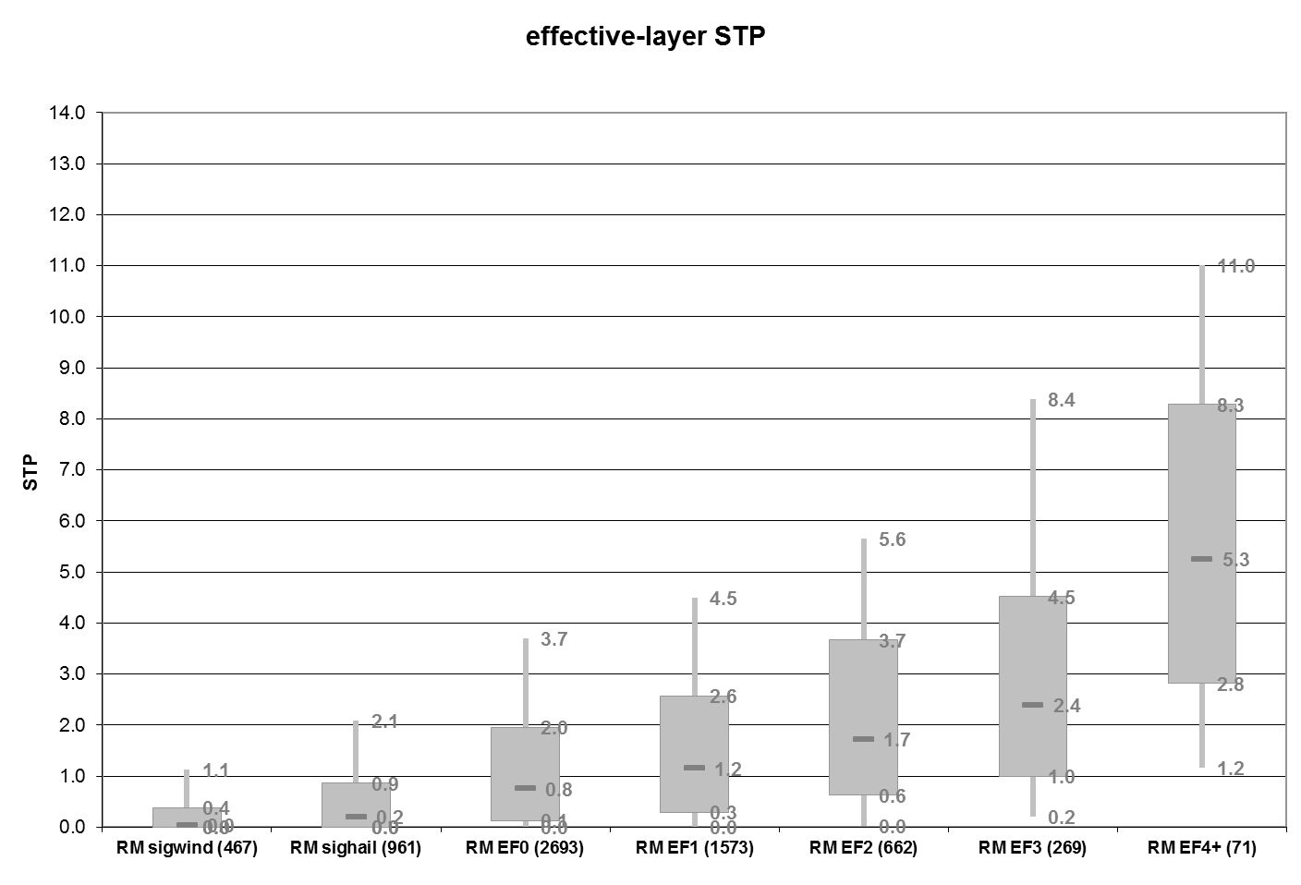
Want to isolate these!

Slide 47
Fixed-Layer STP
MLCAPE
SBCAPE
MLCIN
SBCIN
EBWD
0-6 km BWD
ESRH
0-1 km SRH
MLLCL
SBLCL
Otherwise, uses the same formulation!

Slide 48
Effective vs. Fixed Layer STP
SBCAPE is less dependent on RAP moisture profile above the surface & is more responsive in SPC Mesoanalysis
Fixed-layer terms aren’t as sensitive to errors in the thermo profile or storm-motion estimates
No replication of Eff. layer terms
Examine closely when the two vary substantially!

Slide 49
STP Strengths
Gives single parameter to characterize the potential for significant tornadoes
Is rooted in physical processes relevant to tornadogenesis
Recent studies show combining STP with observed tornado vortex signatures in WSR-88D data can give a reliable estimate of tornado strength in real-time

Slide 50
STP Strengths
Other studies have shown that STP correlates well with tornado occurrence:
“..we conclude that STP is statistically significant covariate to U.S. tornado frequency”
- Gensini and Bravo de Guenni (2019)
when analyzing a 30-year climatology of STP and tornado occurrence

Slide 51
STP Weaknesses Pt. 1
Conditional on the existence of a right-moving, surface-based supercell
Simplified estimate of environments favoring both supercell initiation and sustenance
which are not the same - easier to sustain a supercell in a higher CIN environment than to initiate!
Currently no reliable way to measure/estimate near-surface vorticity generation

Slide 52
STP Weaknesses Pt. 2
Different environments may give the same STP value!
Always look into the environment to see if the parameter value is reasonable!

Slide 53
Different environments may give the same STP value!
Always look into the environment to see if the parameter value is reasonable!
MLCAPE
1500
(200+MLCIN)
150
EBWD
20
ESRH
150
STP =
(2000 - MLLCL)
1000
*
*
*
*
MLCAPE = 500 J/kg
STP = 1.1
Low CAPE/High Shear
Environment
ESRH = 500 m2/s2
EBWD = 20 m/s
MLCIN = -150 J/kg
MLLCL = 1000 m

Slide 54
Different environments may give the same STP value!
Always look into the environment to see if the parameter value is reasonable!
MLCAPE
1500
(200+MLCIN)
150
EBWD
20
ESRH
150
STP =
(2000 - MLLCL)
1000
*
*
*
*
MLCAPE = 5000 J/kg
STP = 1.1
High CAPE/Low Shear
Environment
ESRH = 50 m2/s2
EBWD = 20 m/s
MLCIN = -150 J/kg
MLLCL = 1000 m

Slide 55
Different environments may give the same STP value!
Always look into the environment to see if the parameter value is reasonable!
MLCAPE
1500
(200+MLCIN)
150
EBWD
20
ESRH
150
STP =
(2000 - MLLCL)
1000
*
*
*
*
MLCAPE = 5000 J/kg
Same STP value, but which environment is more favorable for tornadoes?
STP = 1.1
High CAPE/Low Shear
Environment
ESRH = 50 m2/s2
EBWD = 20 m/s
MLCIN = -150 J/kg
MLLCL = 1000 m

Slide 56
The Main Point
Spend time understanding how each parameter works
It can save you from making incorrect assumptions about the environment!

Slide 57
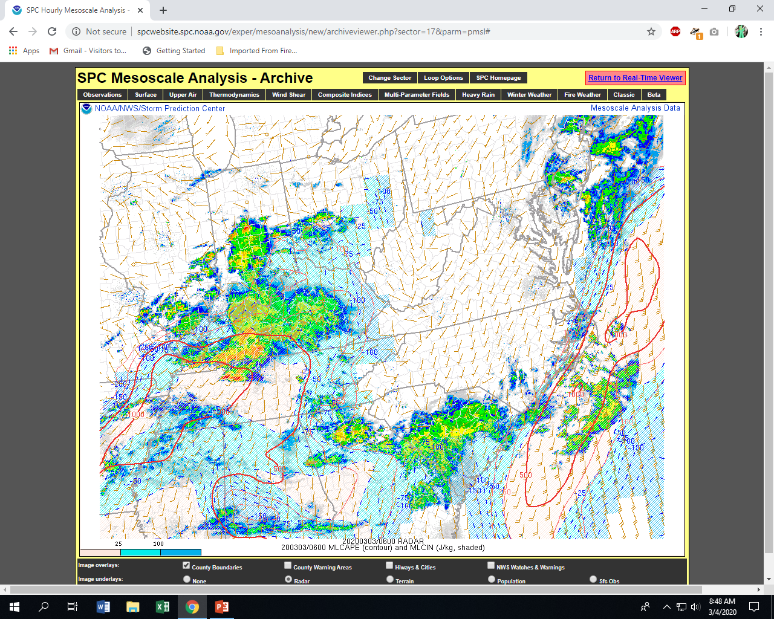

Slide 58
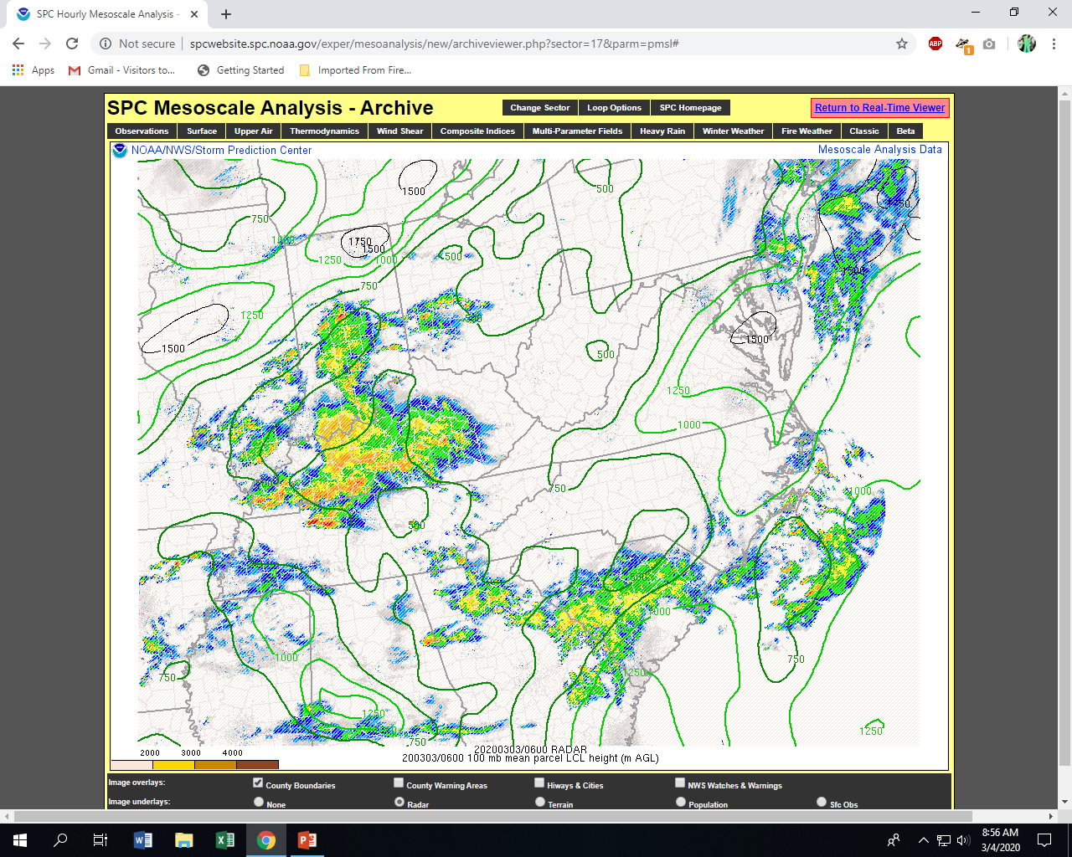

Slide 59
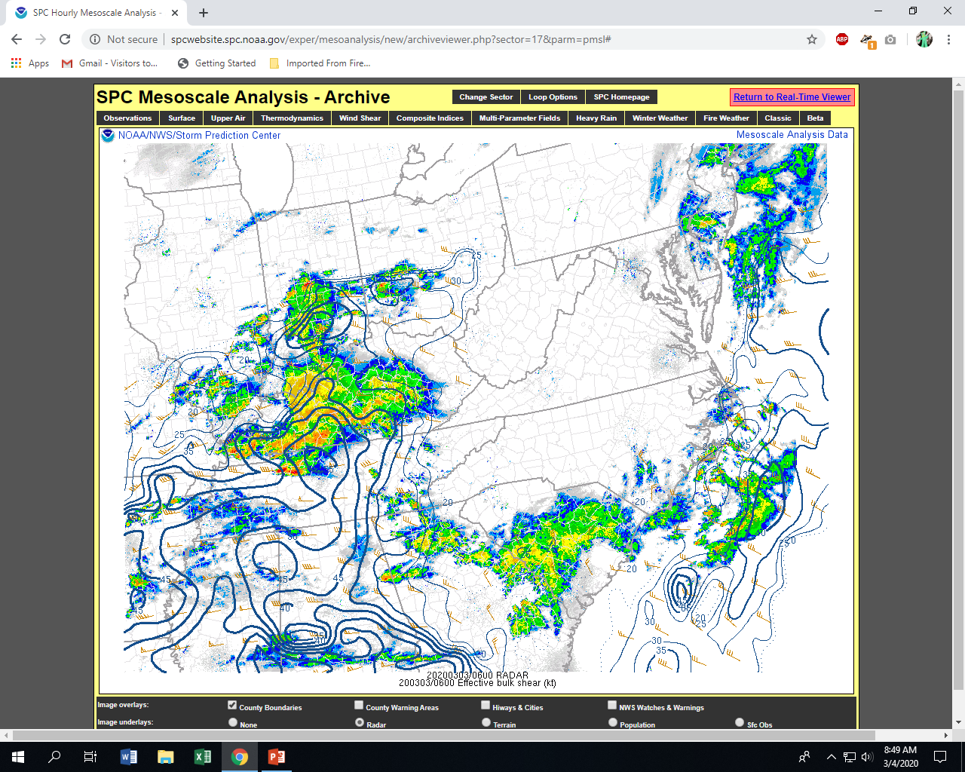

Slide 60
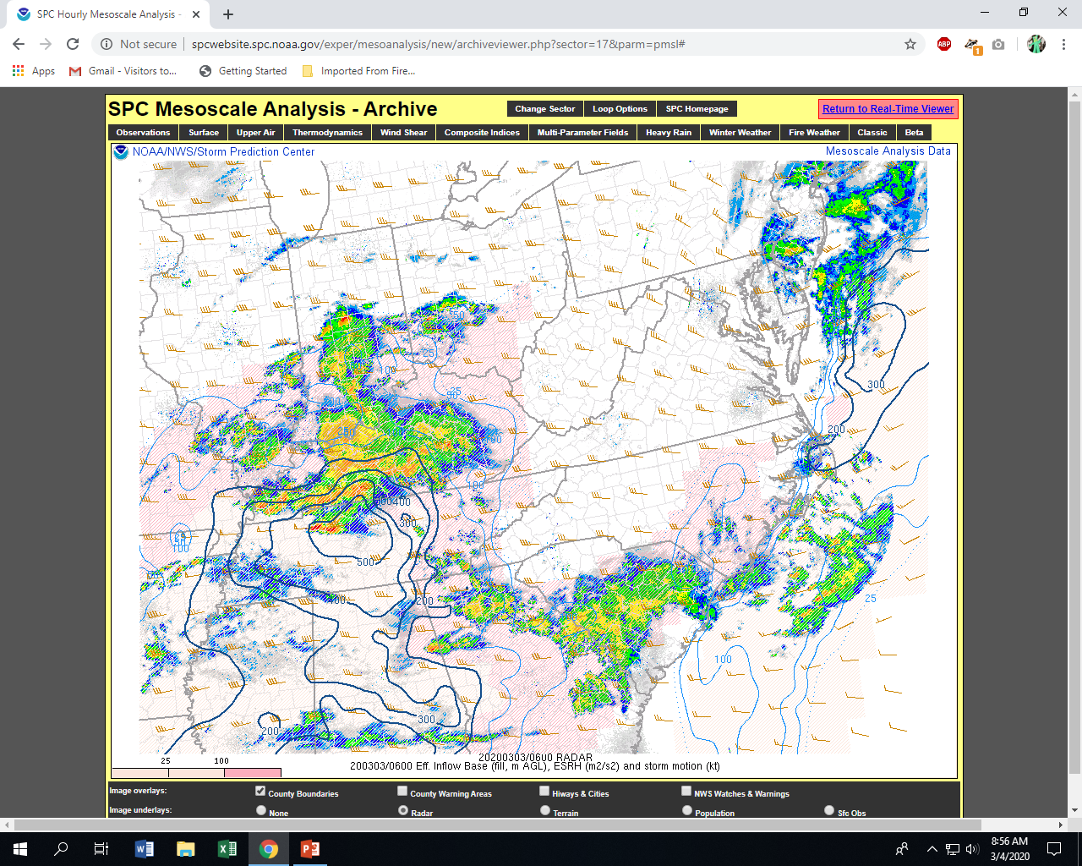

Slide 61
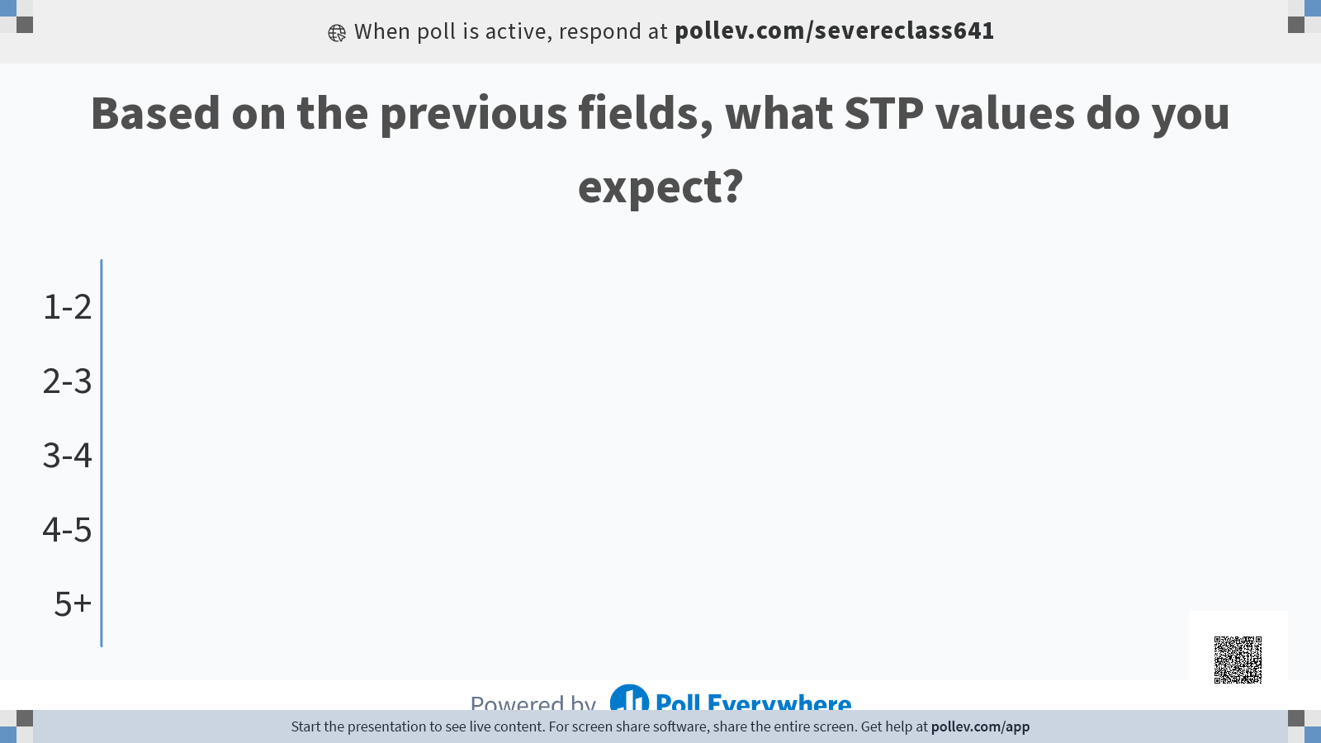

Slide 62
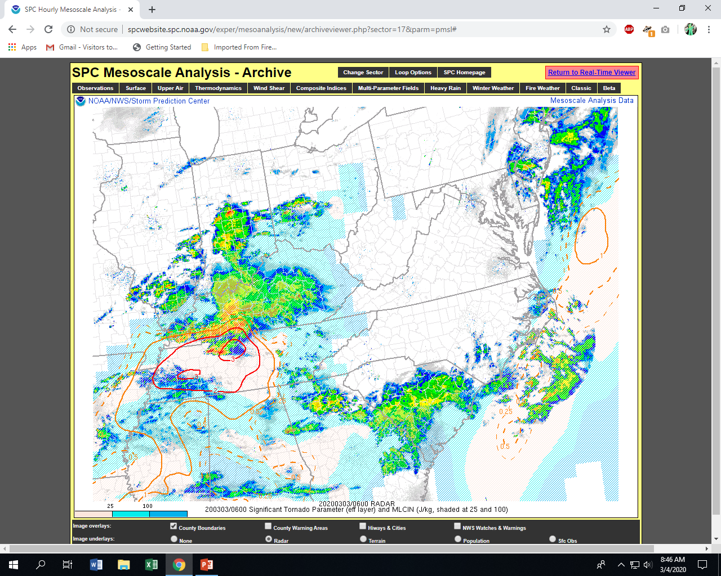

Slide 63
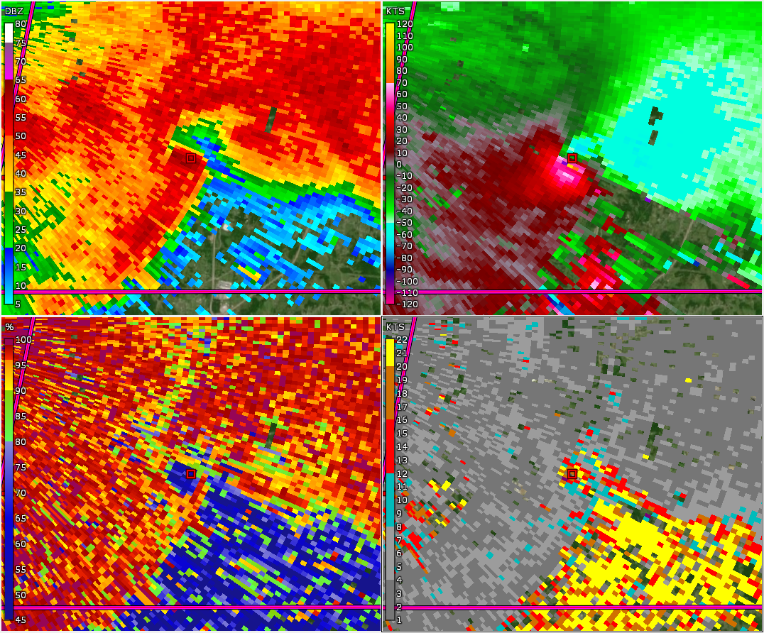
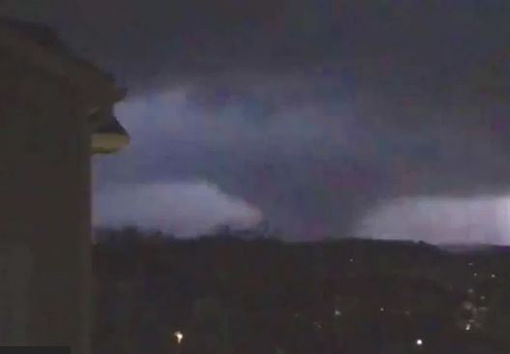
March 2nd, 2020
Cookville, TN
EF-4

Slide 64
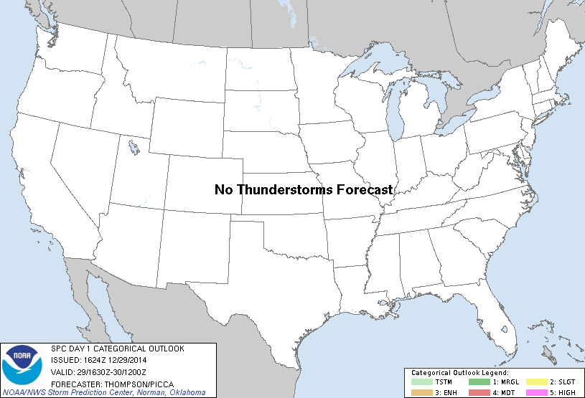
29 December 2014 supercell

Slide 65
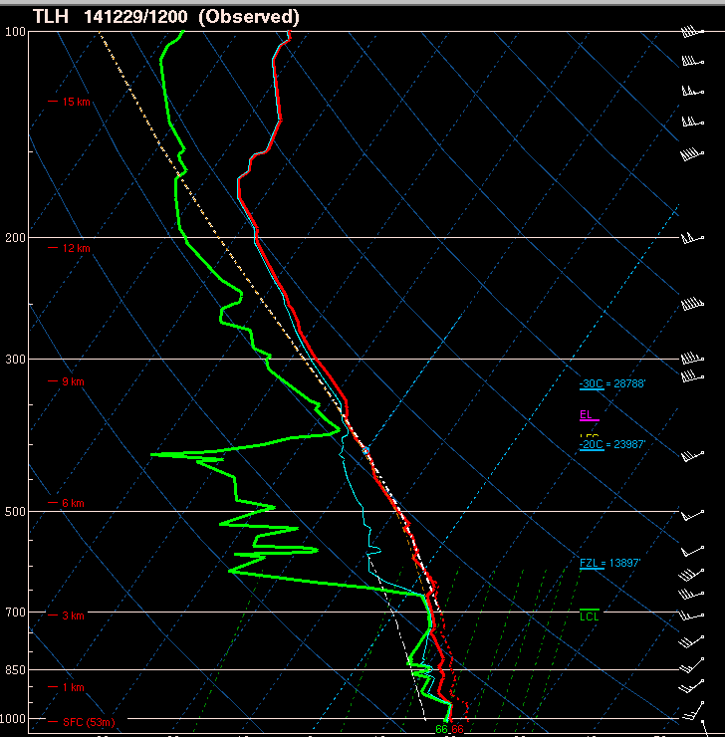
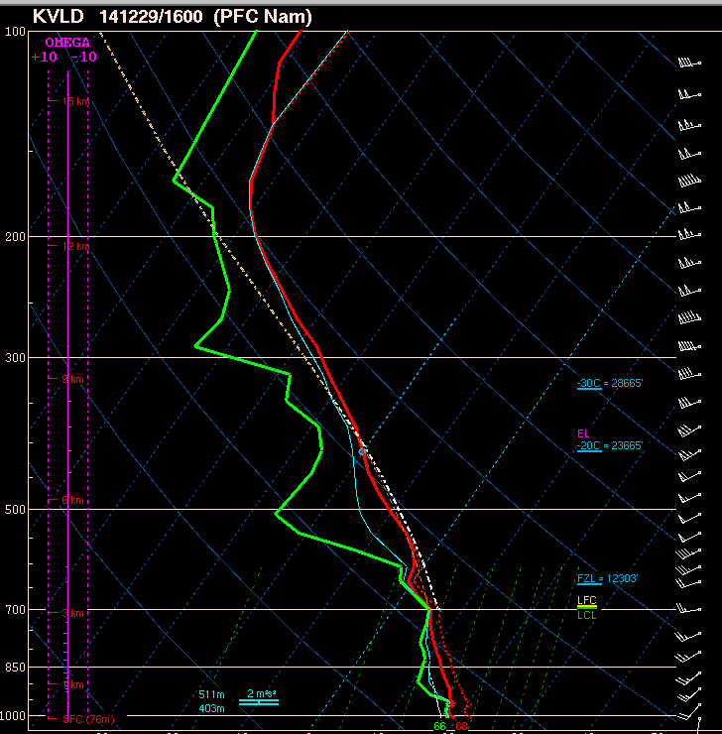

Slide 66
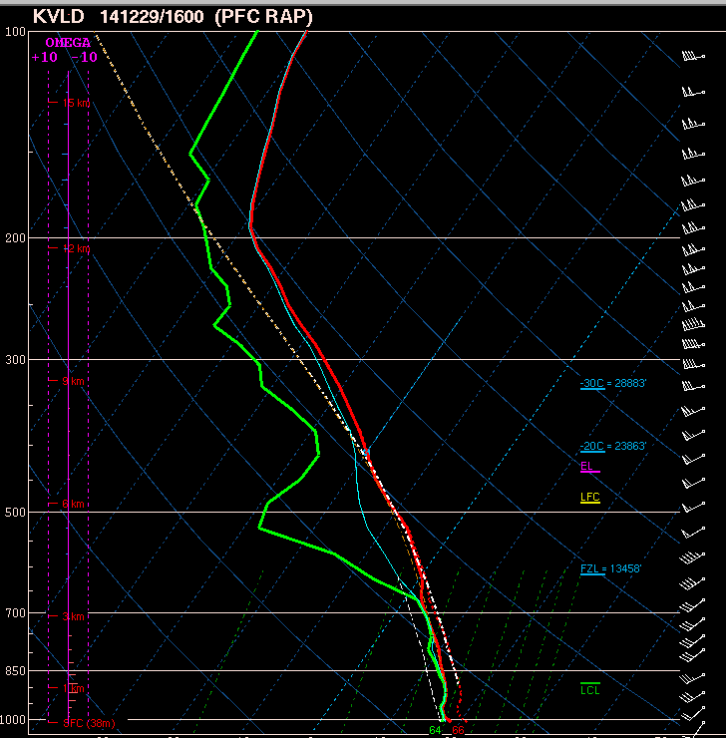
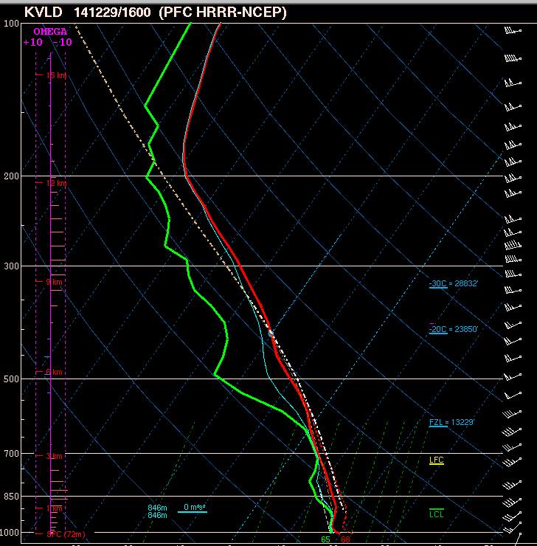

Slide 67
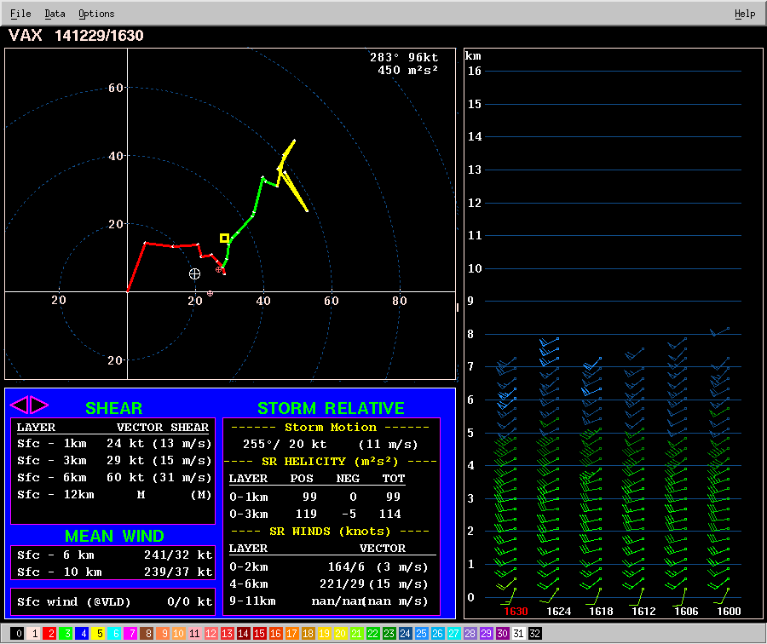
Given the previous forecast soundings and the observed VWP profile on the left…
what value of STP would you expect?

Slide 68
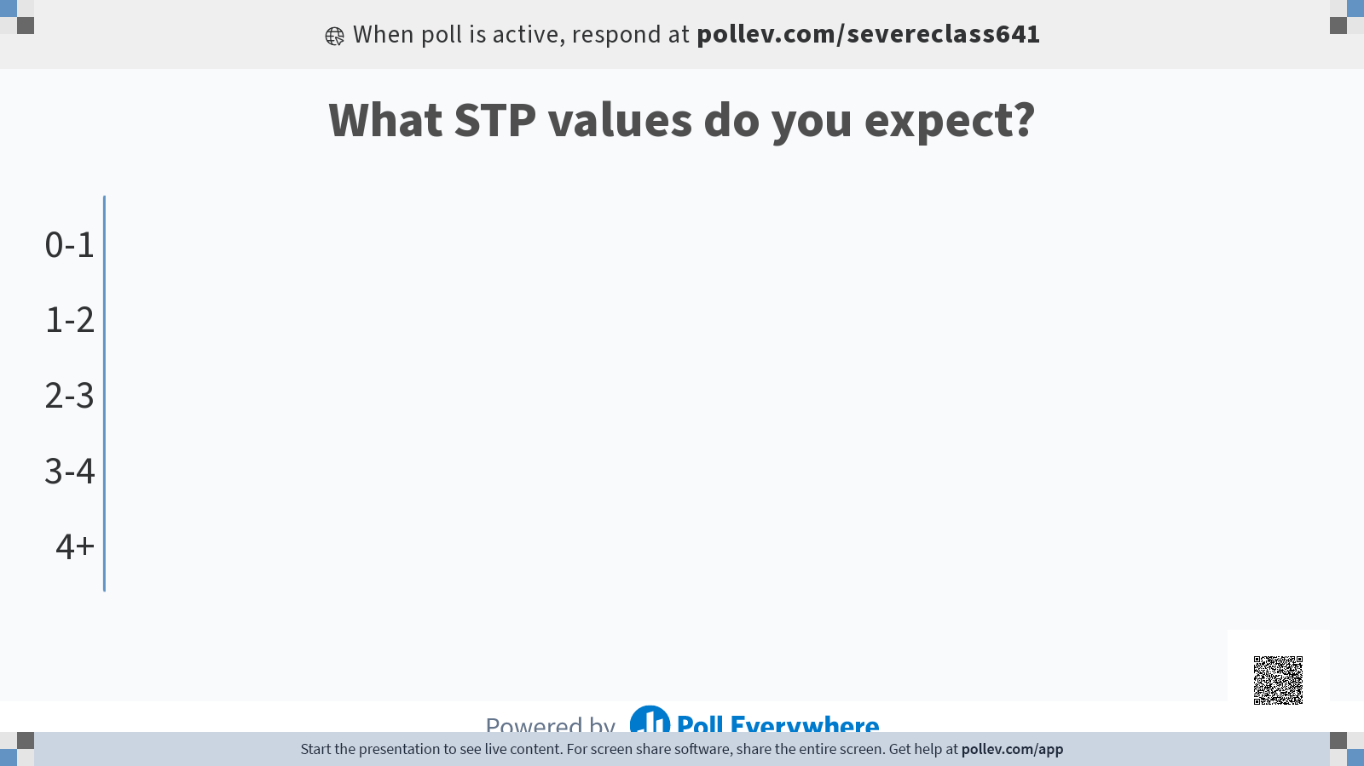

Slide 69
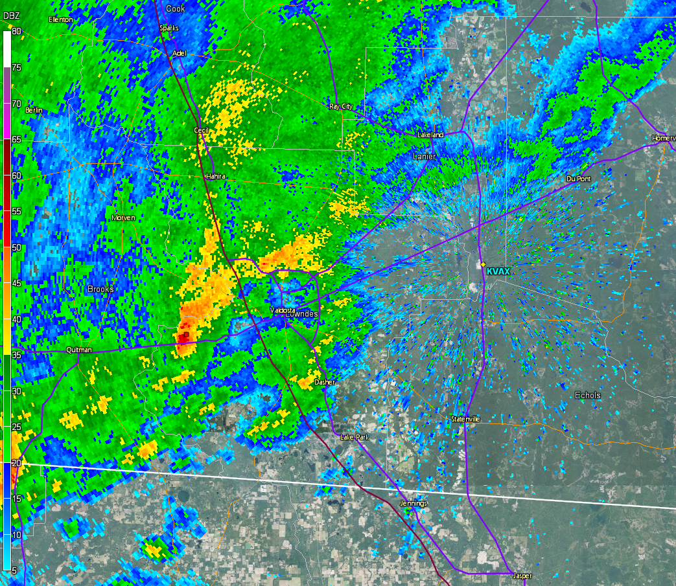

Slide 70
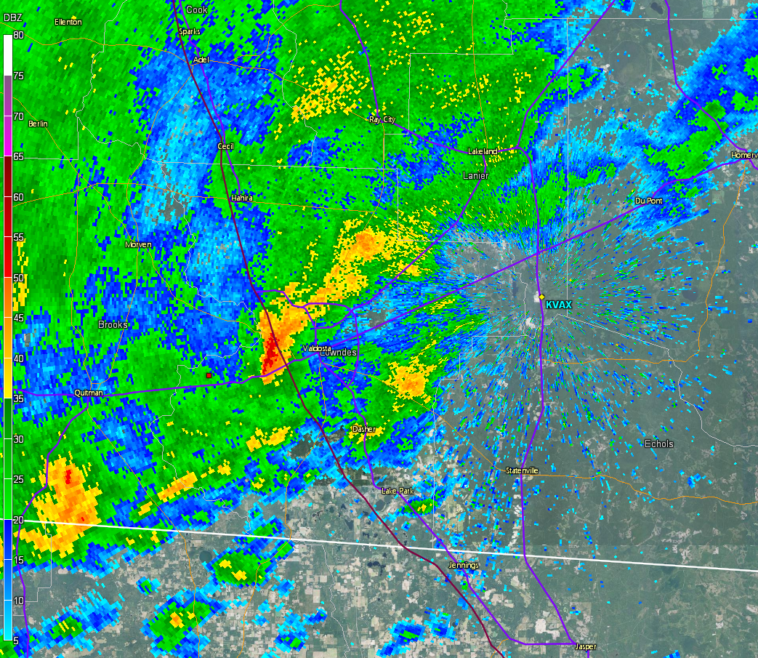

Slide 71
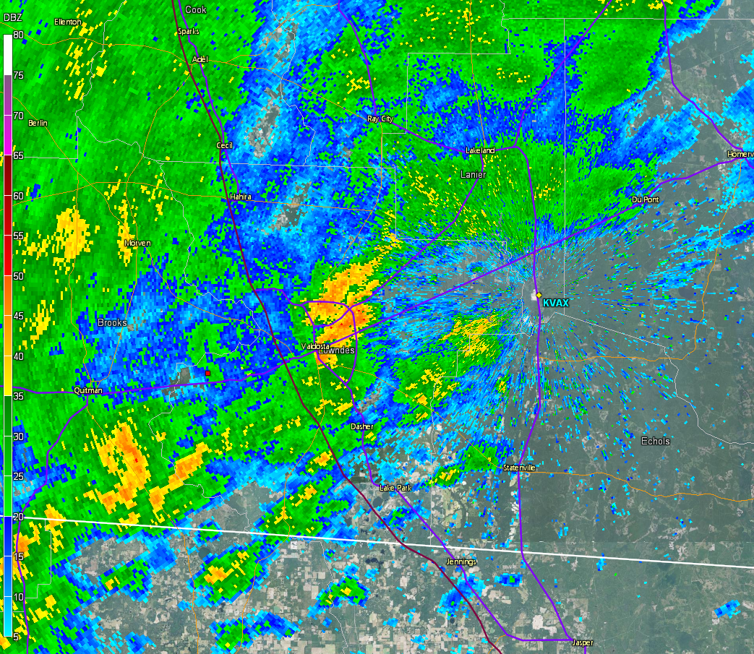

Slide 72
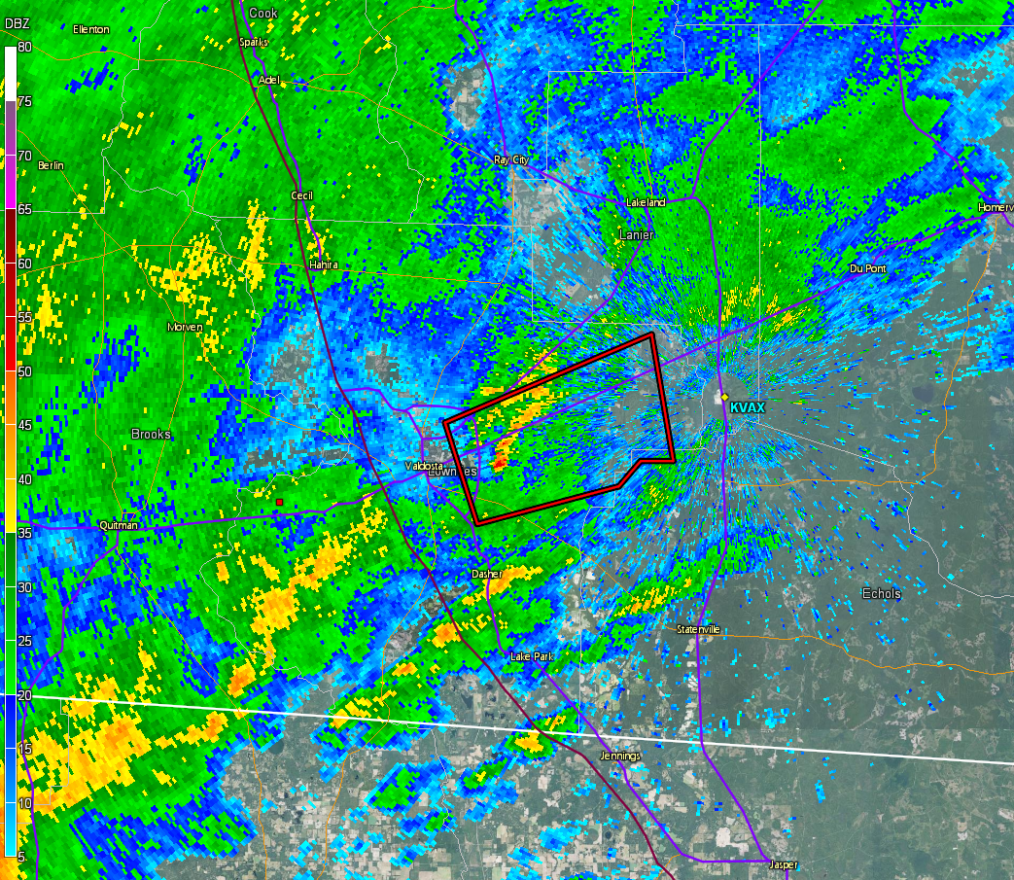

Slide 73
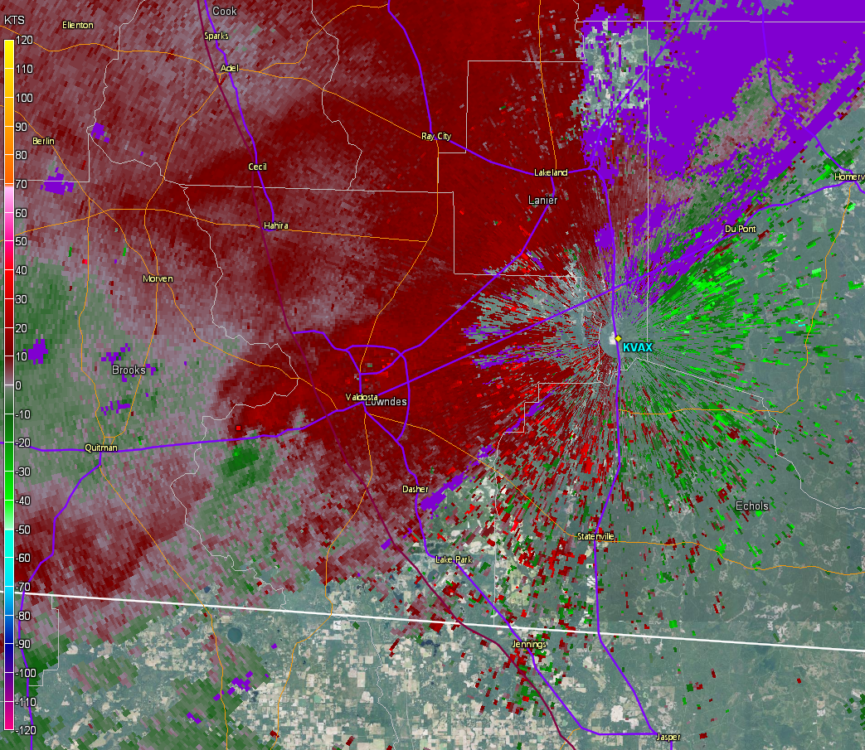

Slide 74
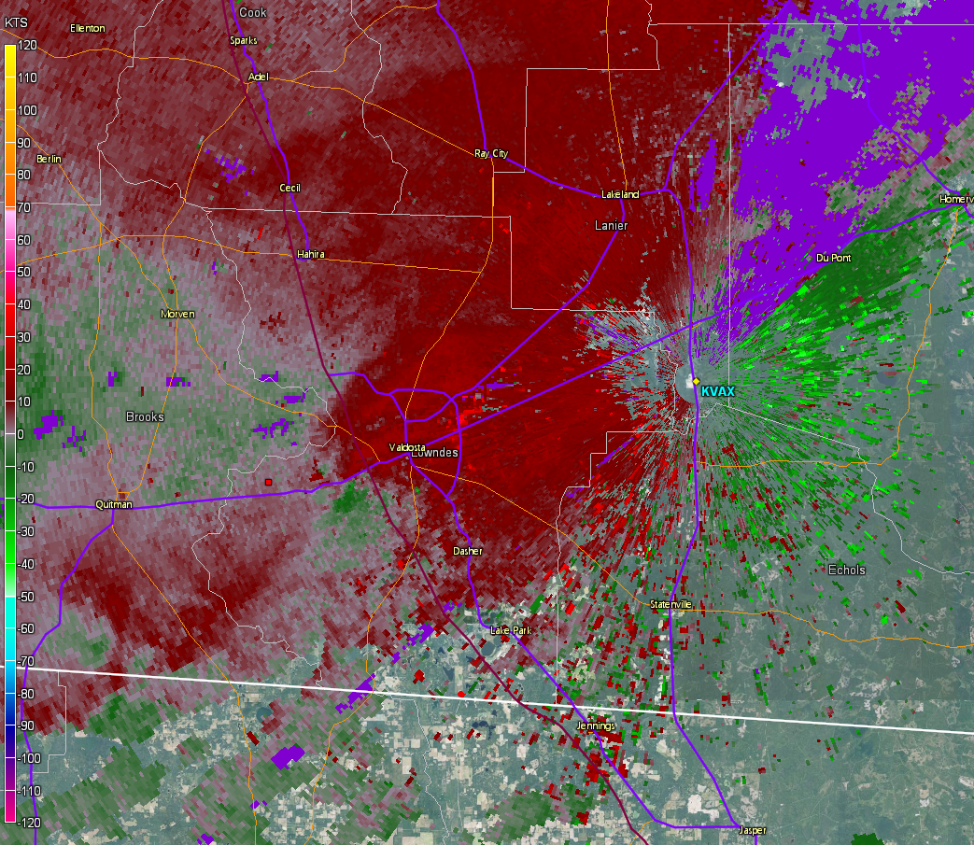

Slide 75
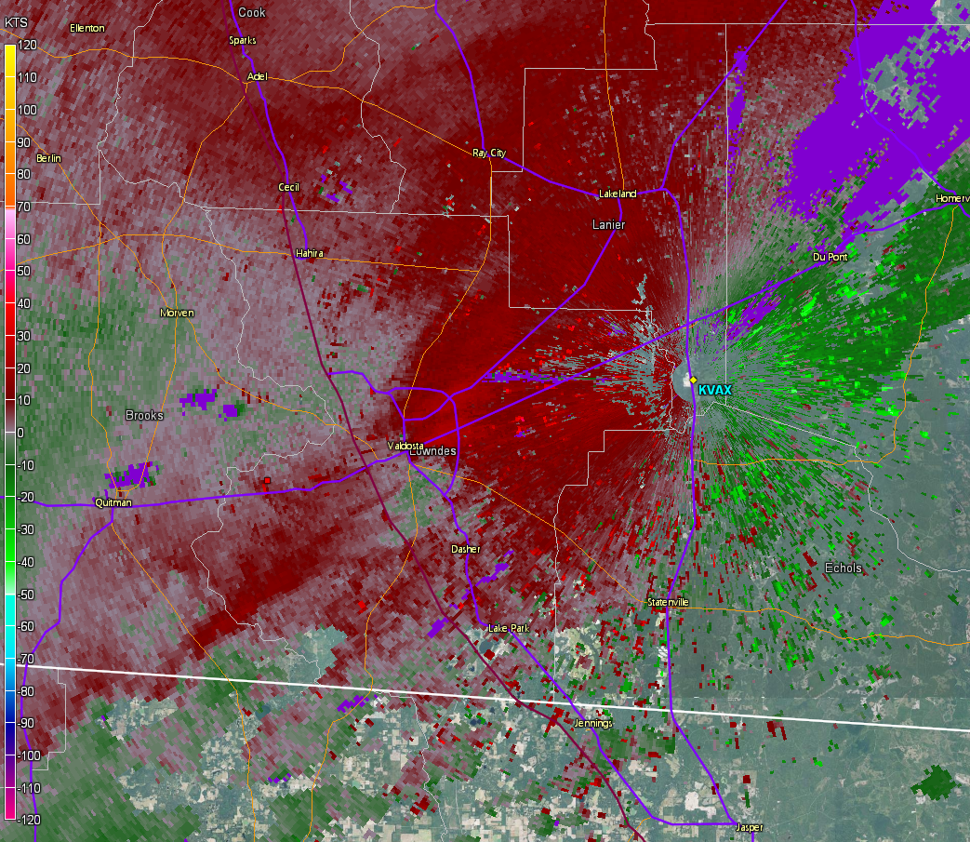

Slide 76
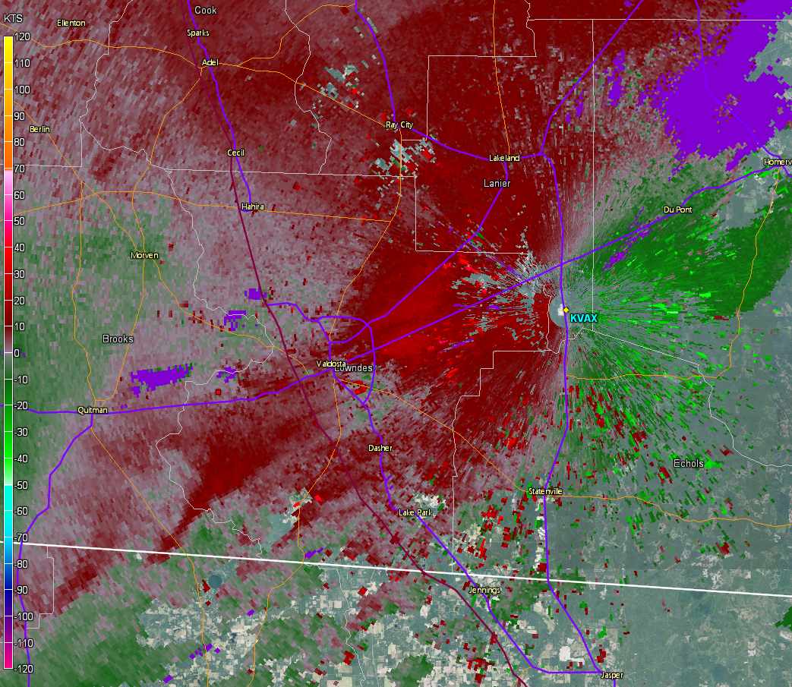

Slide 77
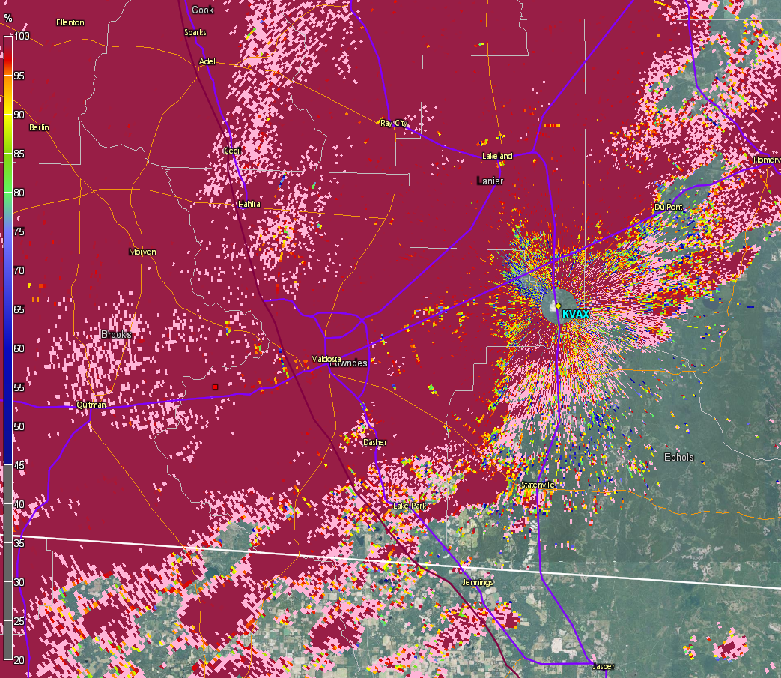

Slide 78
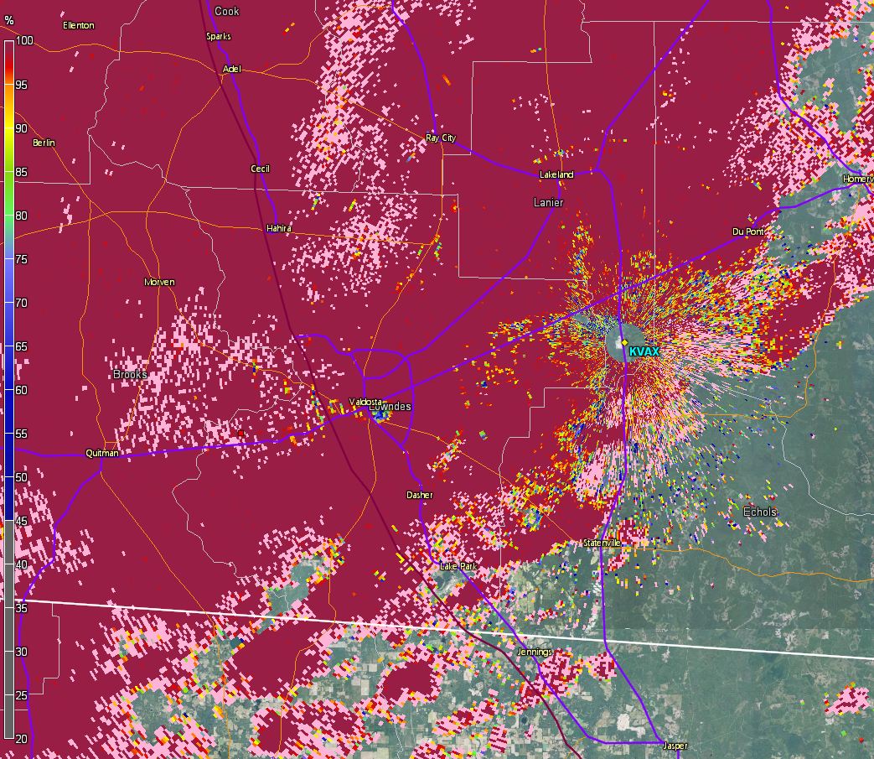

Slide 79
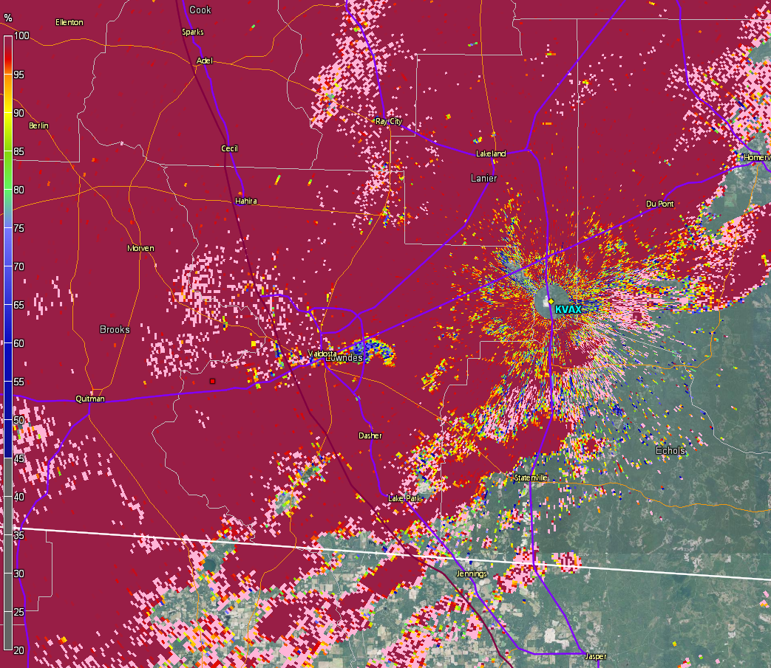

Slide 80
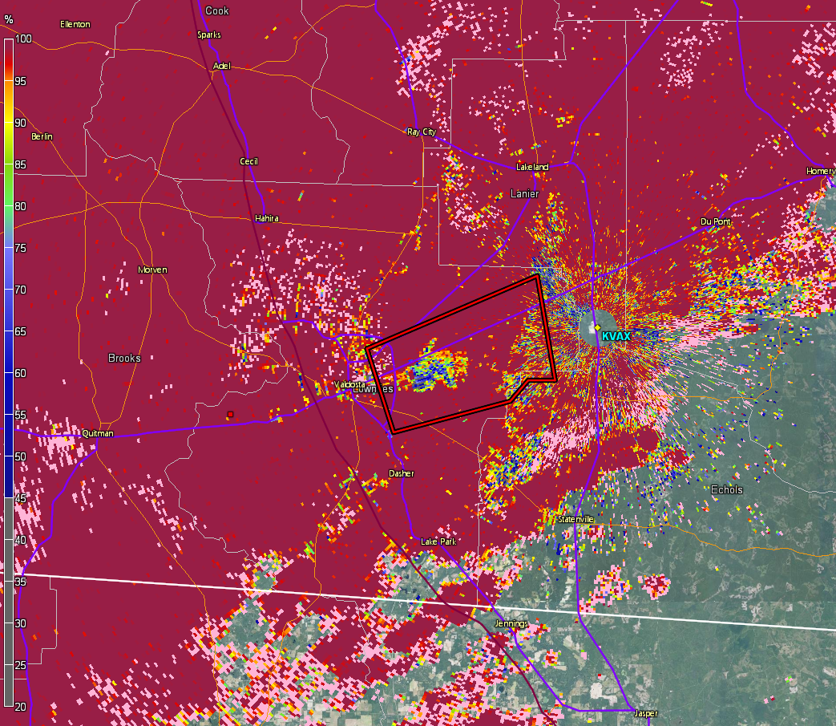

Slide 81
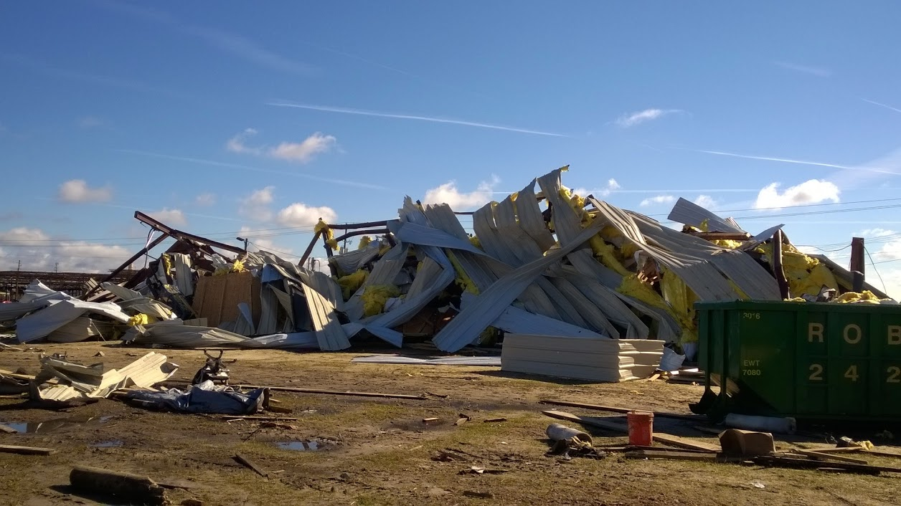
Valdosta, GA
Dec. 29, 2014
EF-2

Slide 82
What if we adjusted the soundings based on nearby surface observations?
This gives a little more MLCAPE, which would increase the STP value to a degree.
But analyses and models may not catch this!

Slide 83
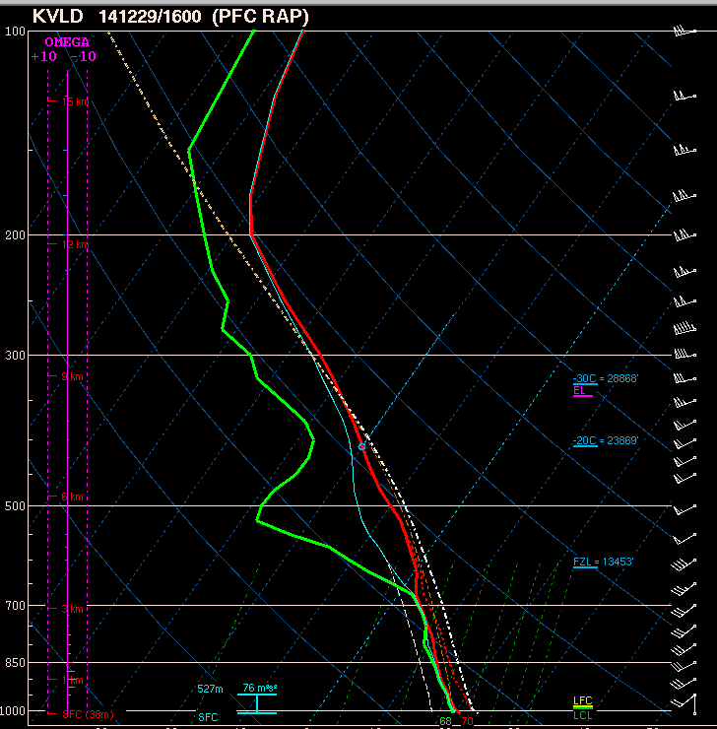
What if we adjusted the soundings based on nearby surface observations?
This gives a little more MLCAPE, which would increase the STP value to a degree.
But analyses and models may not catch this!

Slide 84
No approach is foolproof!
Parameters are useful tools, but should not substitute a thorough analysis of the environment.

